Slide 1
COMP5423 Natural Language Processing

Slide 2
Introduction to Natural Language Process (Part 1)

Slide 3



Introduction to NLP
Communication
Human-to-Human
Human-to-Machine
Machine-to-Machine
Language is a medium of communication that helps us expressing and conveying our thoughts, feelings, and emotions.
Notes:
Throughout human history, the development of language has gone through a very long evolutionary process. The technology advancement has paved the way for automating numerous human activities with computer systems and machines. In many situations, then, there arises a need for humans to provide instructions to machines based on the dynamic environments and specific scenarios. In certain unsafe scenarios, machines are even required to communicate and collaborate among themselves to accomplish complex tasks.
curiosity [ˌkjʊriˈɑsəti] driven

Slide 4


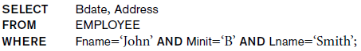
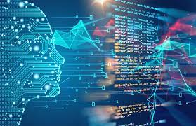
Introduction to NLP
Natural Language Processing (NLP)
Retrieve the birth date and address of the employee(s) whose name is ‘John B. Smith’.
Natural Language Human Language
Un-Structured
Structured
Processing
Application of Computational Techniques to the Analysis of Natural Language
Notes:
Unstructured vs Structured
Human language and computer language are two distinct forms of communication that serve different purposes. While programming languages are way simpler than human languages, there isn't much grammar, there is mostly syntax — word order and spelling.
SQL stands for Structured Query Language. SQL is used to communicate with a database.
interpret
US [ɪnˈtɜrprət]
Semantic Parsing: From Query to SQL

Slide 5
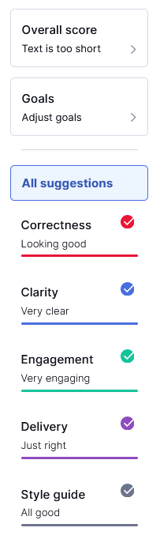
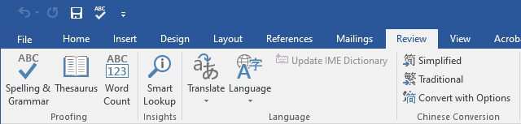


Introduction to NLP
Applications of NLP
Spelling and Grammar Check
Notes:
NLP enjoys a wide range of applications. To say a few …,

Slide 6

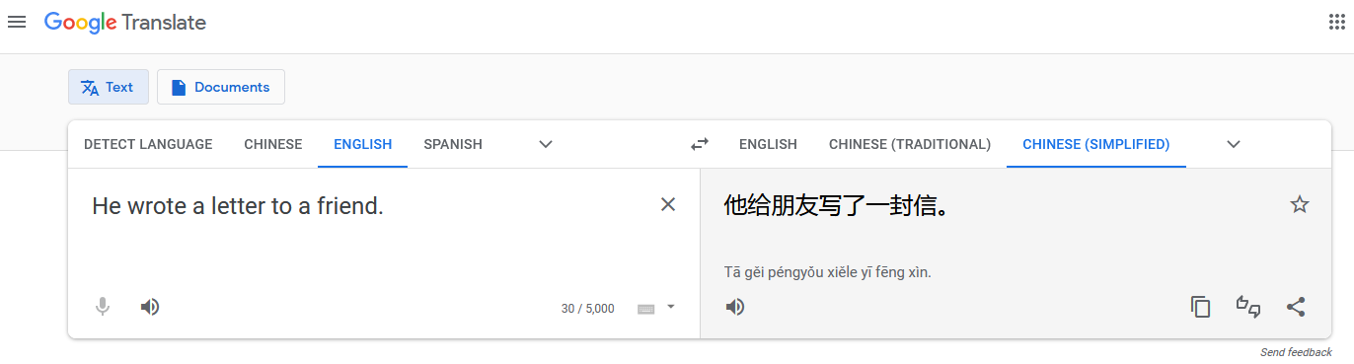
Introduction to NLP
Applications of NLP
Machine Translation (MT)
Google Translate was launched in April 2006 as a statistical machine translation service. As of December 2024, it supports 249 languages.
Notes:
Launched in April 2006 as a statistical machine translation service.
As of December 2022, Google Translate supports 133 languages. (https://en.wikipedia.org/wiki/Google_Translate)
As of December 2024, it supports 249 languages. It is about twice as large as it was two years ago.
Make friends internationally.
Get information.

Slide 7
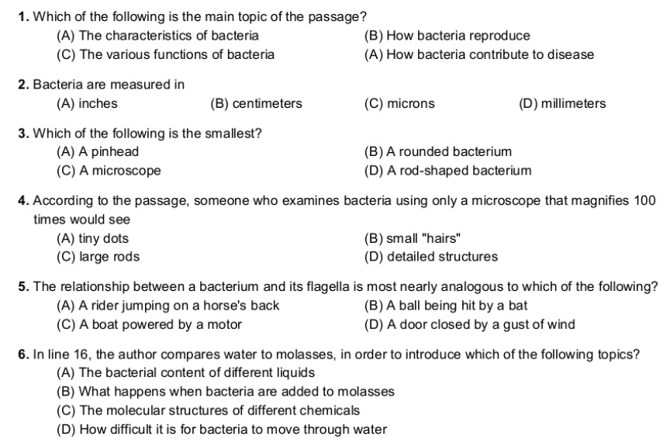
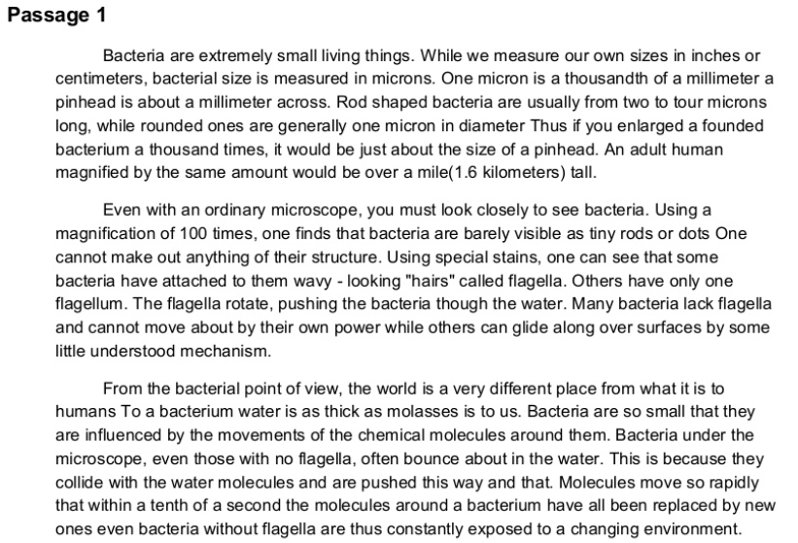
Introduction to NLP
Applications of NLP
Question Answering (QA)
Multiple Choice QA
Notes:
Asking and answering questions is crucial for learning and obtaining knowledge.

Slide 8
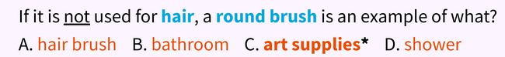
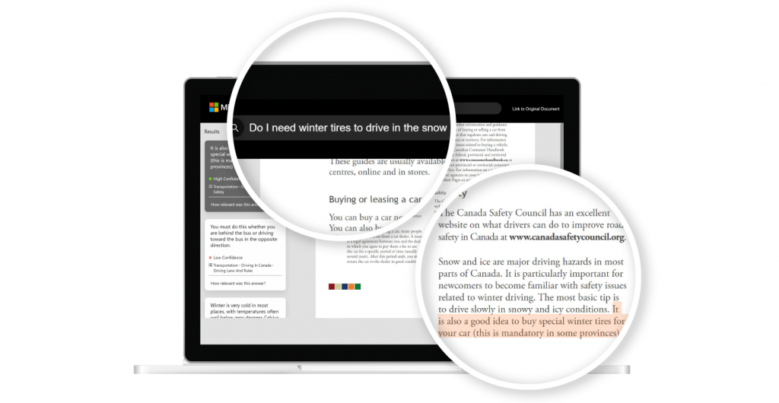
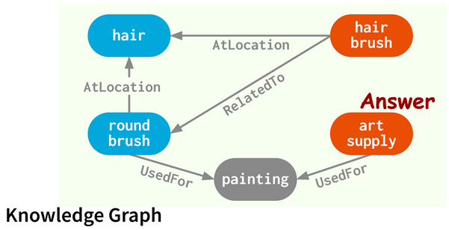
Introduction to NLP
Applications of NLP
Question Answering (QA)
Knowledge-based QA (KBQA)
Document-based QA (DBQA)
Notes:
Knowledge base question answering (KBQA) aims to answer a natural language question over a knowledge base (KB) as its knowledge source.

Slide 9
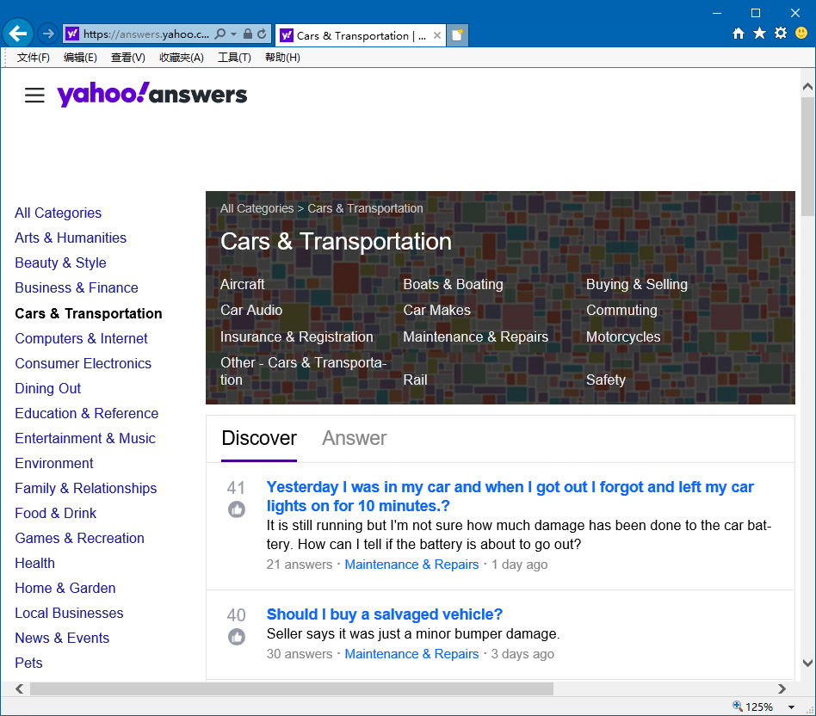



Introduction to NLP
Applications of NLP
Question Answering (QA)
Community QA

Slide 10
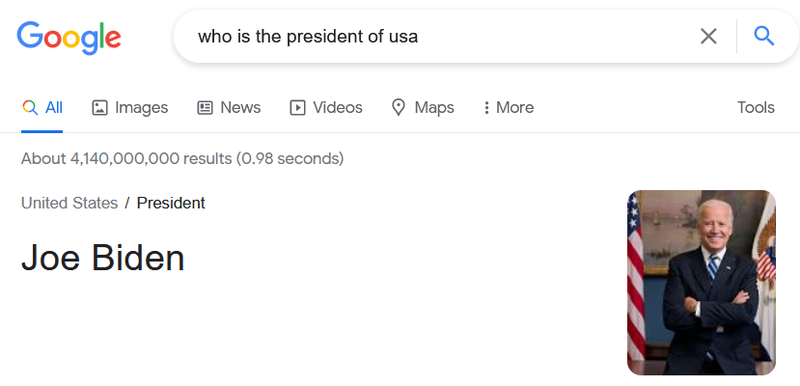
Introduction to NLP
Applications of NLP
Question Answering (QA)
Open Domain QA

Slide 11




Introduction to NLP
Applications of NLP
Dialogue Systems (aka. Chatbots)
Task-Oriented vs. Non-Task-Oriented (Social-Oriented)

Slide 12



Introduction to NLP
Applications of NLP
Web Search

Slide 13
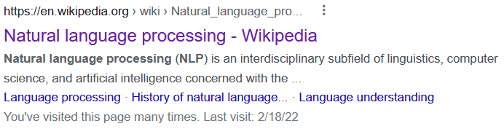
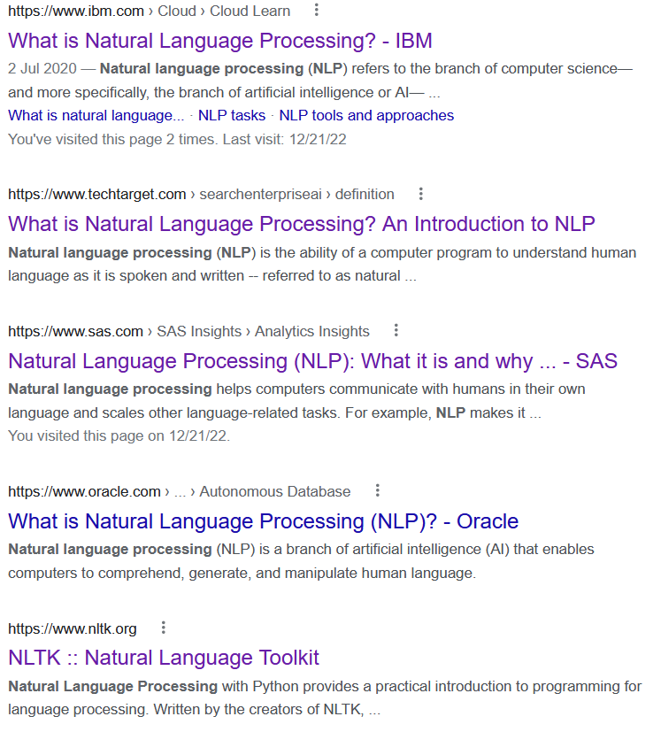
Snippets

Slide 14
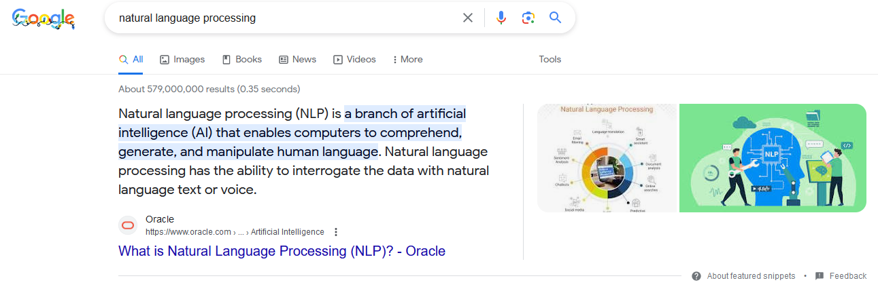
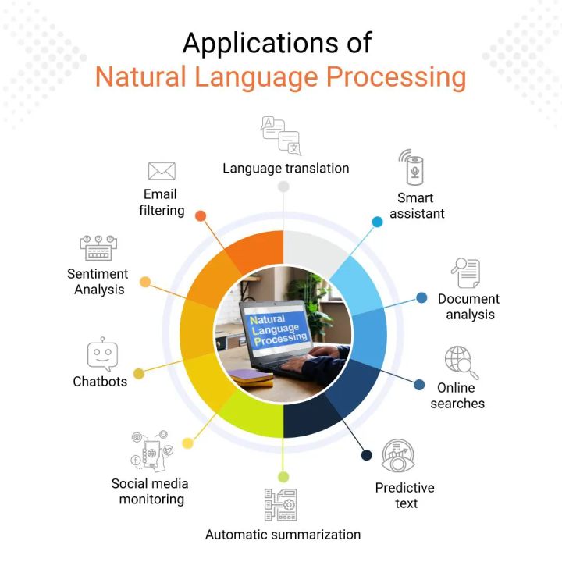
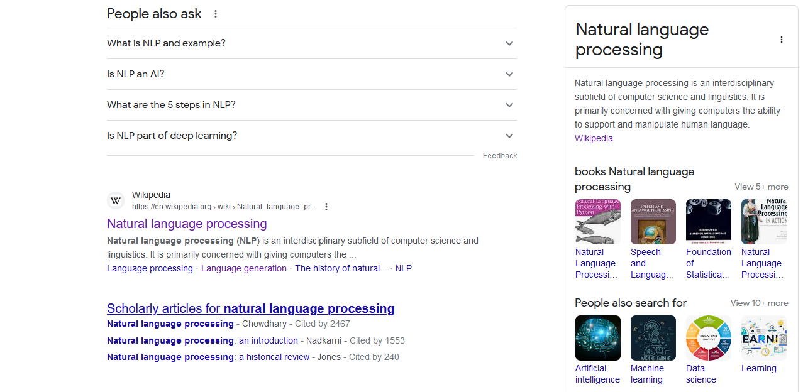
Notes:
In 2012, Google introduced their Knowledge Graph, building on DBpedia and Freebase among other sources.

Slide 15
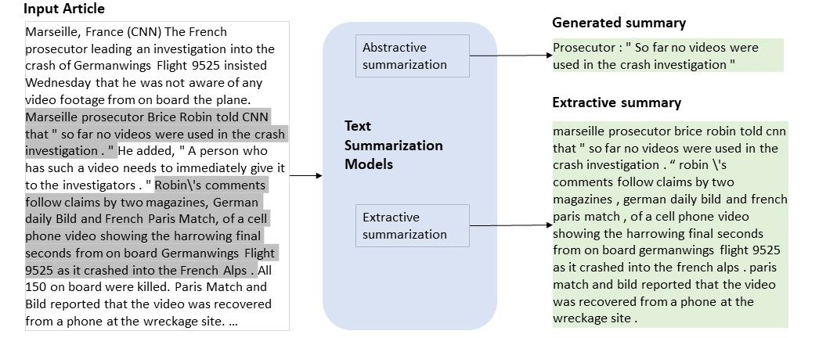
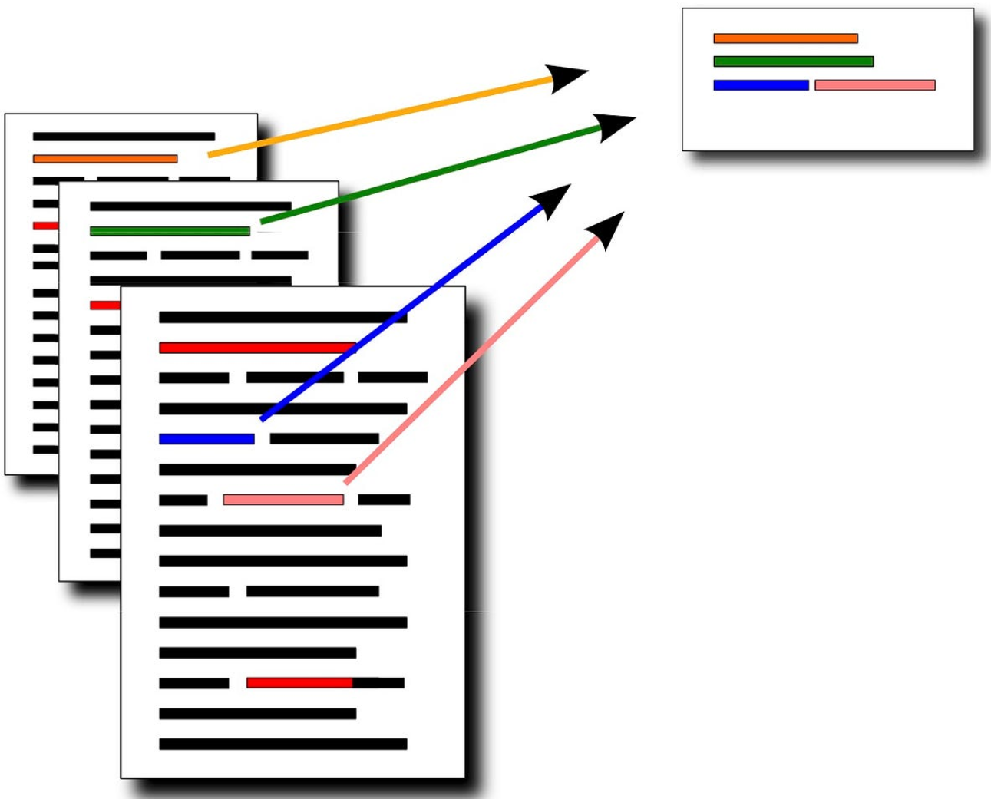
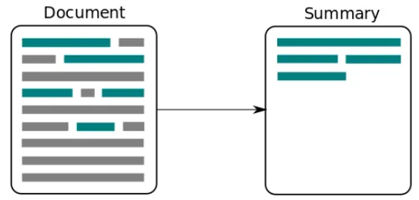

Introduction to NLP
Applications of NLP
Automatic Text Summarization
Single Document Summarization
Mult-Document Summarization
Query-Oriented Summarization

Slide 16
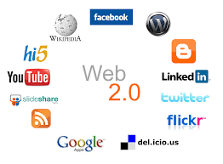

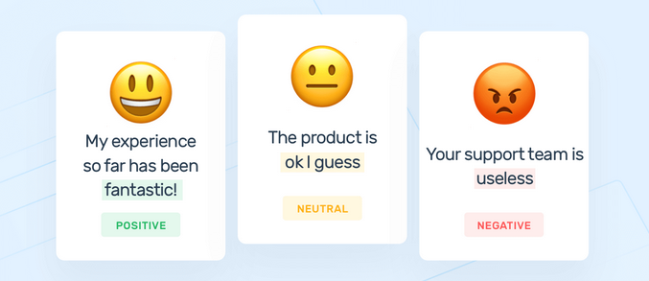
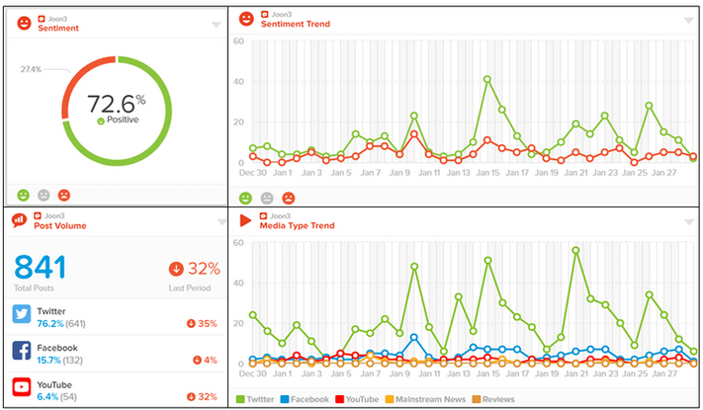
Introduction to NLP
Applications of NLP
Social Medial Monitoring
Sentiment Classification
Notes:
Web 2.0 are websites and applications that make use of user-generated content for end users.
Opinions
Sentiment polarity for an element defines the orientation of the expressed sentiment, i.e., it determines if the text expresses the positive, negative or neutral sentiment of the user about the entity in consideration.
Responding promptly serves as an emergency public relations mechanism and helps to resolve issues, ultimately enhancing customer satisfaction.
policies and politicians [ˌpɒləˈtɪʃ(ə)n]

Slide 17
Introduction to NLP
Tasks in NLP
Two Fundamental Tasks
Natural Language Understanding
Natural Language Generation

Slide 18
Introduction to NLP
Natural Language Understanding Hierarchy
Morphological Analysis
Syntactic Analysis
Semantic Analysis
Discourse Analysis
Tokenization, Lemmatization,
Stemming,
Word Segmentation
Word Sense Disambiguation,
Word Embedding
Word-Level
Part-of-Speech Tagging, Syntactic Parsing, Chunking/Shallow Parsing
Semantic Role Labeling, Frame Semantic Parsing, Abstract Meaning Representation
Sentence-Level
Text Granularity
Co-Reference Resolution, Discourse Coherence
Document-Level
Notes:
Morphological knowledge concerns how words are constructed from morphemes.
Syntactic knowledge concerns how words can be put together to form correct sentences and determines what structural role each word plays in the sentence and what phrases are subparts of what other phrases.
Semantic knowledge concerns what words mean and how these meanings combine in sentences for form sentence meanings.
Discourse knowledge concerns how the immediately preceding sentences affect the interpretation of the next sentence.

Slide 19
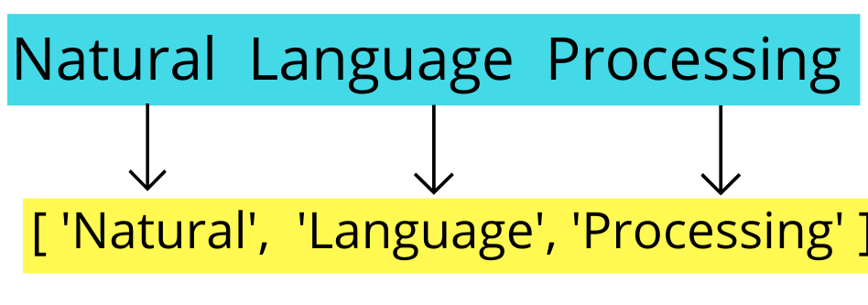
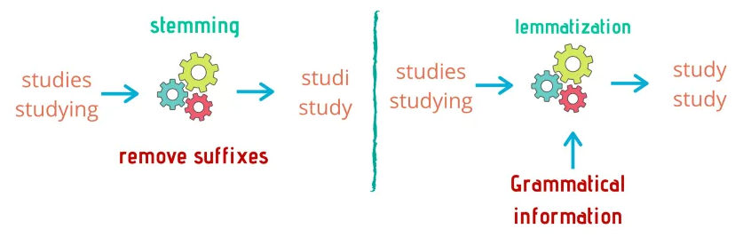
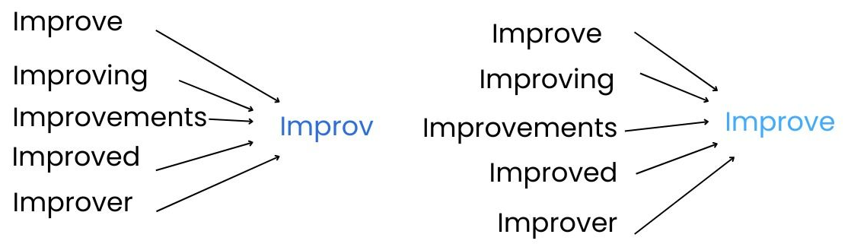
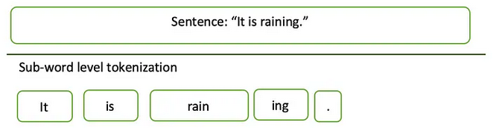
Introduction to NLP
Tokenization/Segmentation
Lemmatization/Stemming
下雨天留客天留我不留
下雨,天留客.天留, 我不留!
下雨天,留客天.留我不,留!
Lemmatization is to reduce inflectional forms (surface form) and sometimes derivationally related forms of a word to a common lemmatized (base, root) form or lemma. Stemming is a naive version of morphological analysis which simply strip off affixes.
Given a sequence of characters, word tokenization is the task of chopping it up into pieces, called word tokens. Word tokenization in Chinese is known as Chinese Word Segmentation, identifying the boundaries of words.
Notes:
Lemmatization: Restore to the original forms.

Slide 20
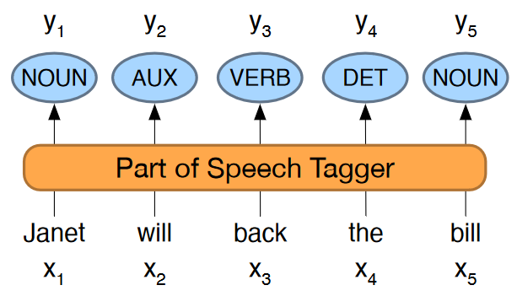
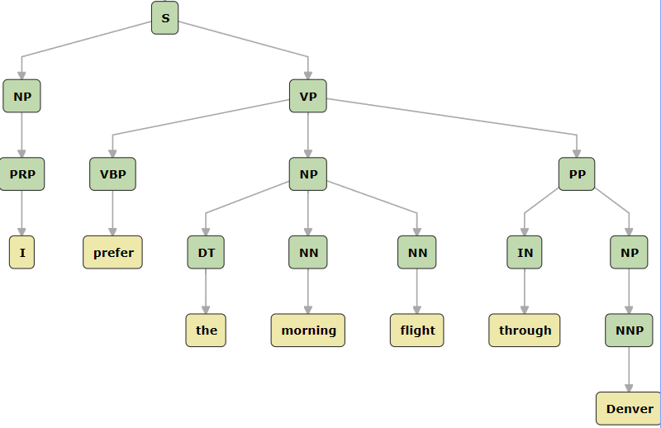
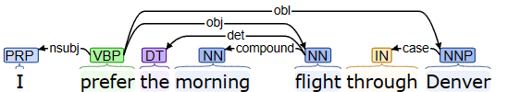
Introduction to NLP
Part-of-Speech Tagging
Syntactic Parsing
Chunking/Shallow (Partial) Parsing
[_{NP} The morning flight] from [_{NP} Denver]
[_{VP} has arrived].
Chunking is to identify the non-overlapping segments of a sentence, such as noun phrases, verb phrases, adjective phrases, and prepositional phrases.
Part-of-Speech (for short POS) is the name for a group words, which have similar grammatical functions, such as noun, verb, pronoun, proposition, adverb, and conjunction, etc. Part-of-Speech tagging is a task of assigning a Part-of-Speech tag (like noun, verb, adjectives) to each word in a sentence.
Syntactic parsing to assign a syntactic structure to a sentence. Constituency parsing focuses on the constituent (phrase) structure, while dependency parsing describes the syntactic structure with of the grammatical relations that hold among the words.
Notes:
be composed of

Slide 21


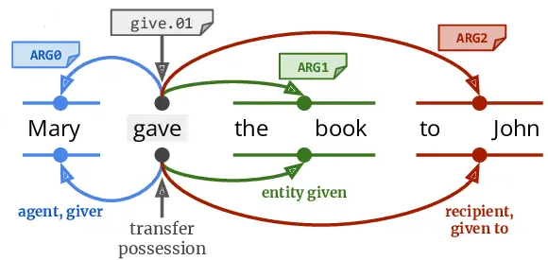
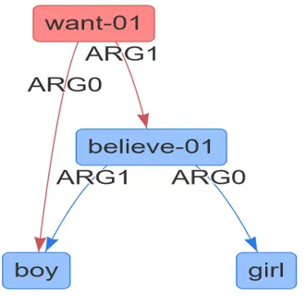
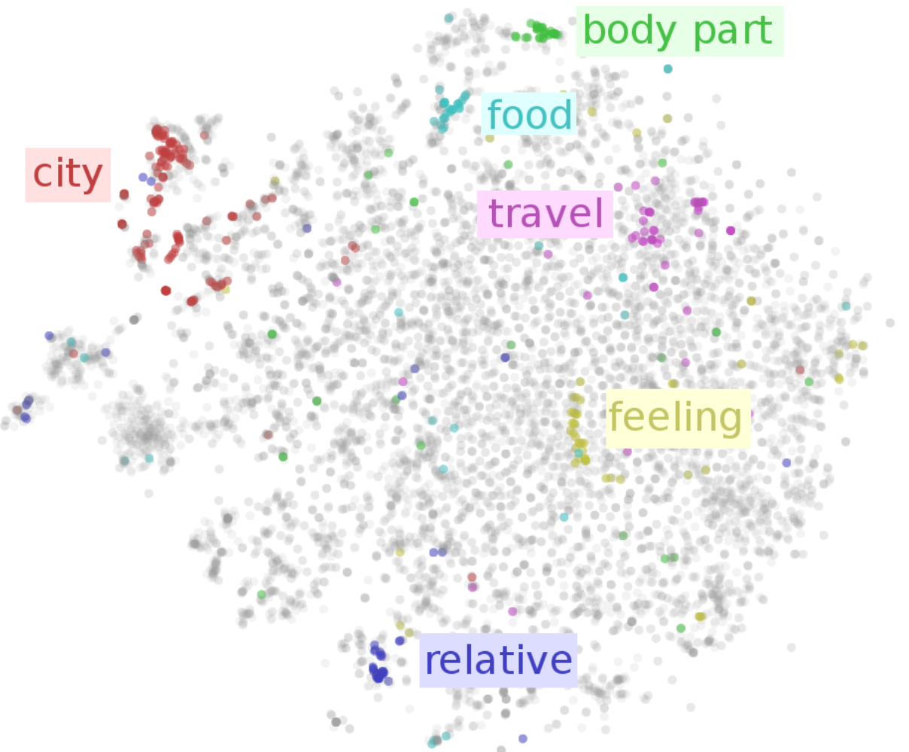

Introduction to NLP
Word Sense Disambiguation
Semantic Role Labeling
Abstract Meaning Representation (AMR) Parsing
Most words have many different senses. Word sense disambiguation (WSD) is a task of determining which sense of a word is being used in a particular context.
Semantic role labeling is the task of assigning roles to spans in sentences, such as predicate, agent, patient, time, location, and instrument, etc.
Abstract Meaning Representation (AMR) is a semantic representation language. AMR graphs are rooted, labeled, directed, acyclic graphs (DAGs), comprising whole sentences.
Word Embeddings
Notes:
super-class vs. sub-class
recipient [rɪ'sɪpiənt]

Slide 22
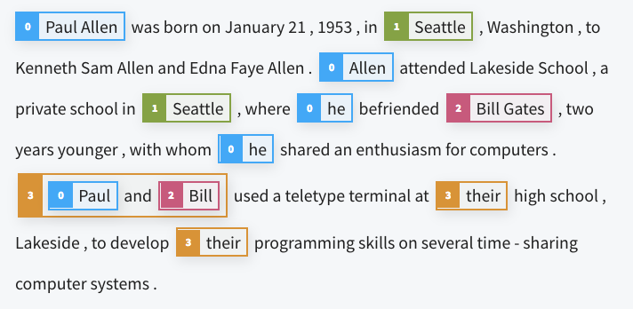
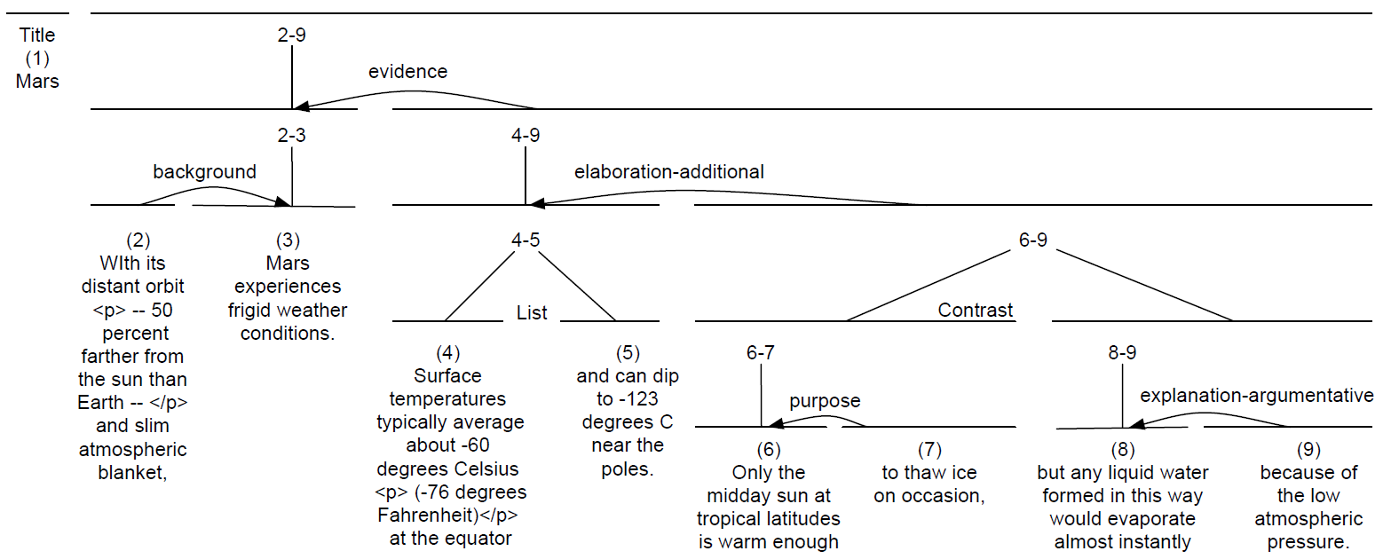
Introduction to NLP
Co-Reference Resolution
Discourse Coherence
In information extraction (IE), a (named) entity is a real-world object, such as a person, location, organization, product, etc., that can be denoted with a proper name.
Co-reference resolution is the task of determining whether two mentions (of entities) co-refer.
Coherent discourses are structured by coherence relations that hold between text units, e.g., defined in Rhetorical Structure Theory (RST) . Given a sequence of sentences, the task of automatically determining the coherence relations between Elementary Discourse Units (EDU, Nuclear or Satellite) is called RST parsing.
Notes:
rhetorical [rɪˈtɒrɪk(ə)l]
Nuclear or Satellite [ˈsætəlaɪt]
Relations: Reason, Elaboration, Evidence, Attribution, List

Slide 23

Introduction to NLP
Why do we care about coherence of a discourse?
John wanted to buy a piano for his living room.
Jenny also wanted to buy a piano.
He went to the piano store.
It was nearby.
The living room was on the second floor.
She didn’t find anything she liked.
The piano he bought was hard to get up to that floor.
Entity-based Coherence
Notes:
Entity-based Coherence
Say something off topic…
Well structured

Slide 24
Introduction to NLP
Tasks in NLP
Natural Language Understanding
Morphological/Lexical Analysis
Morphological knowledge concerns how words are constructed from morphemes.
Key Concepts: Tokenization, Stemming/Lemmatization, Chinese Word Segmentation

Slide 25
Introduction to NLP
Tasks in NLP
Natural Language Understanding
Syntactic Analysis
Syntactic knowledge concerns how words can be put together to form correct sentences and determines what structural role each word plays in the sentence and what phrases are subparts of what other phrases.
Key Concepts: Part-of-Speech (POS) Tagging, Syntactic Parsing (Constituency Parsing, Dependency Parsing), Chunking, Context-Free Grammar (aka. Phrase-Structure Grammar)

Slide 26
Introduction to NLP
Tasks in NLP
Natural Language Understanding
Semantic Analysis
Semantic knowledge concerns what words mean and how these meanings combine in sentences to form sentence meanings.
Key Concepts: Word Sense Disambiguation, Word Embedding, Semantic Role Labeling, Frame Semantic Parsing, Abstract Meaning Representation, First Order Logic (aka. Predicate Calculus)

Slide 27
Introduction to NLP
Tasks in NLP
Natural Language Understanding
Discourse Analysis
Discourse knowledge concerns how the immediately preceding sentences affect the interpretation of the next sentence.
Key Concepts: Co-Reference Resolution, Discourse Coherence

Slide 28


Introduction to NLP
Tasks in NLP
Natural Language Understanding
(Reading)
Natural Language Generation
(Writing)
Notes:
How human reads vs. how human writes

Slide 29
Introduction to NLP
Tasks in NLP
Natural Language Generation
Context-Free Grammar (aka. Phrase-Structure Grammar) is the most widely used formal system for modeling constituent structure in natural languages.
Lexicon: Words (such as fly, Sunday) and Syntactic Symbols (such as Noun (denoted as N), Noun Phrase (denoted as NP))
Rules (or Productions): Each expresses the ways that words and symbols of the language can be grouped and ordered together.

Slide 30
Introduction to NLP
A CFG can be thought of in two ways.
As a device for assigning a structure to a given sentence
As a device for generating sentences
NP → ProperNoun
NP → Det Nominal
Nominal → Noun
NP
Det
Nominal
Det → a
Det → the
Noun → flight
Noun
a flight
Parsing
→ means to rewrite the symbol on the left with the sequence of symbols on the right.

Slide 31

Introduction to NLP
A CFG can be thought of in two ways.
As a device for assigning a structure to a given sentence
As a device for generating sentences
NP → ProperNoun
NP → Det Nominal
Nominal → Noun
NP
Generation
Det
Nominal
Det → a
Det → the
Noun → flight
Noun
a
flight
→ means to rewrite the symbol on the left with the sequence of symbols on the right.

Slide 32
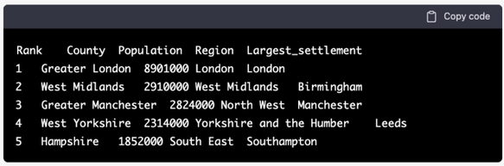
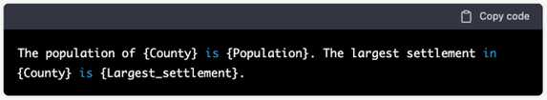
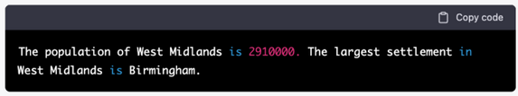
Introduction to NLP
Tasks in NLP
Natural Language Generation
Template based Generation
Relational Database
Pre-defined Template
Natural Language Sentence

Slide 33
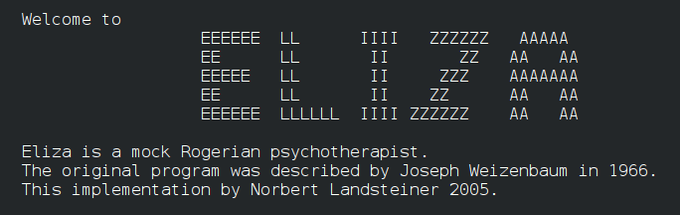
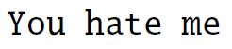
Introduction to NLP
Tasks in NLP
Natural Language Generation
Pattern Recognition and Transformation Rules

Slide 34
Introduction to NLP
Tasks in NLP
Natural Language Generation
Statistical (N-Gram) or Neural Language Model based Generation (Word-by-Word Generation)
The man is walking
down
Predicted Next Words
The man is walking down
the
The man is walking down the
street
The man is walking down the street
.
* In 1980, the first significant statistical language model was proposed.
Notes:
A language model is a probabilistic model of a natural language. In 1980, the first significant statistical language model was proposed. (more than 40 years ago.)

Slide 35
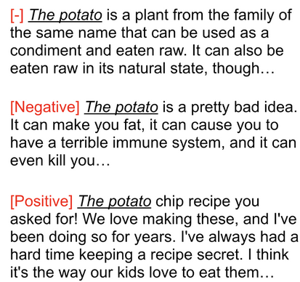

Introduction to NLP
Tasks in NLP
Natural Language Generation
Application Scenarios: Story Generation, Report Generation, Summary Generation, Question/Answer Generation, Response/Dialogue Generation, etc.
Conditional/Controllable Generation
Personalized and Stylized Generation
Notes:
Language models are useful for a variety of tasks, including speech recognition, machine translation, optical character recognition, handwriting recognition, information retrieval, and other natural language generation tasks.
Personalized Generation and Stylized [ˈstaɪˌlaɪzd] Generation
Personalized Generation: here has been a significant emphasis on research that enables the generation of personalized text – text that reflects the author’s style and content more accurately.
Stylized Text Generation: In recent studies, researchers are paying increasing attention to modeling and manipulating the style of the generation text, which we call stylized text generation in this tutorial. The goal is to not only model the content of text (in traditional text generation), but also control some “style” of the text, for example, the persona of a speaker in a dialogue (Li et al., 2016), or the sentiment of product reviews.
Advertiser vs Scientist
Funny story or horrible story

Slide 36


Introduction to NLP
Tasks in NLP
Natural Language Generation
Short Text (Sentence) Generation vs. Long Text (Document) Generation vs. Interactive Text (Dialogue) Generation
Content Planning: Decides what information to include and how to structure sentences and paragraphs.
Text Generation: Creates the final output by composing human-readable text.
The man is walking down
The man is walking down the
The man is walking down the street
The man is walking down the street .
Notes:
sentence generation vs. document generation (local view vs. global view)

Slide 37
Introduction to NLP
Tasks in NLP
Textual Entailment (TE) and Natural Language Inference (NLI)
Premise | Label | Hypothesis
A man inspects the uniform of a figure in some East Asian country. | Contradiction | The man is sleeping.
An older and younger man smiling. | Neutral | Two men are smiling and laughing at the cats playing on the floor.
A soccer game with multiple males playing. | Entailment | Some men are playing a sport.
Notes:
premise [ˈpremɪs]
hypothesis [haɪˈpɑθəsɪs]

Slide 38
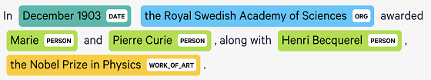
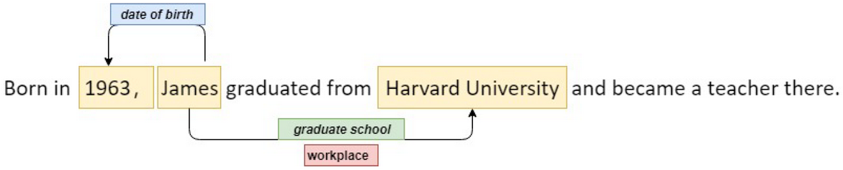
Introduction to NLP
Tasks in NLP
Information Extraction and Knowledge Graphs
(Named) Entity Recognition
A (named) entity is a real-world object, such as a person, location, organization, product, etc., that can be denoted with a proper name.
Relation Detection
Co-Reference Resolution
The task of relation extraction is finding and classifying semantic relations among entities mentioned in a text.
Two or more expressions (i.e., mentions) that are used to refer to the same entity are said to co-refer. Co-reference resolution is the task of determining whether two mentions (of entities) co-refer.

Slide 39
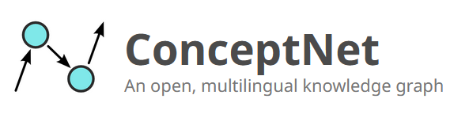
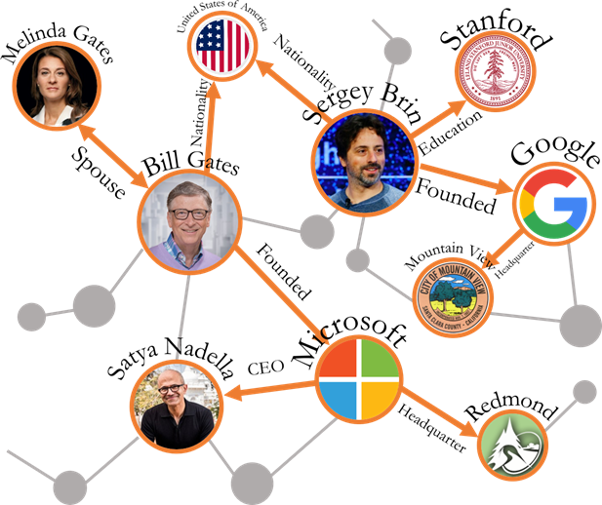

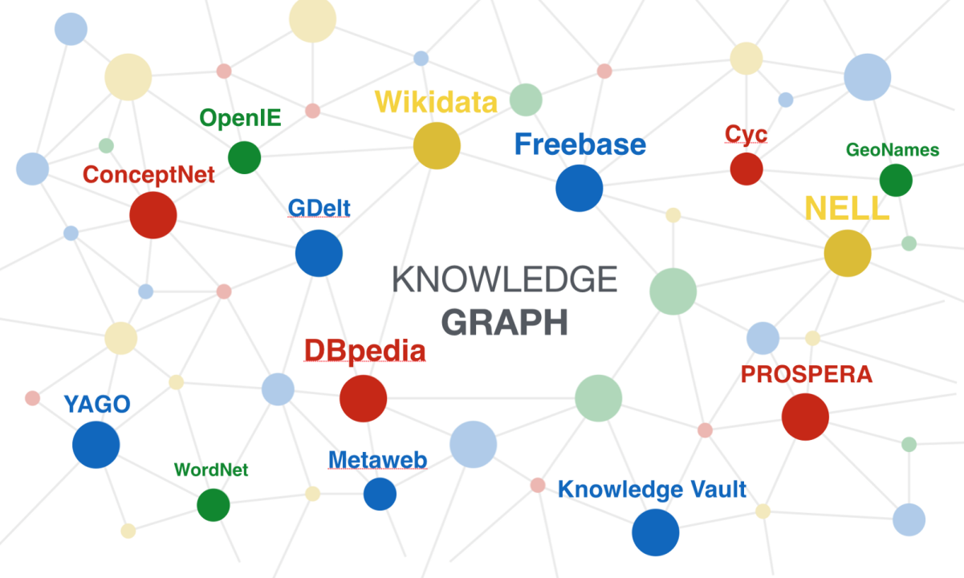
Introduction to NLP
Tasks in NLP
Information Extraction and Knowledge Graphs
A knowledge graph represents a network of real-world entities (i.e., objects and concepts) and illustrates the relationship between them. This information is usually stored as the entity-relation-entity triples in a database and visualized as a graph structure, prompting the term knowledge “graph”.
Notes:
ConceptNet is a freely-available semantic network, designed to help computers understand the meanings of words that people use.
ConceptNet originated from the crowdsourcing project Open Mind Common Sense, which was launched in 1999 at the MIT Media Lab. It has since grown to include knowledge from other crowdsourced resources, expert-created resources, and games with a purpose.
https://www.google.com/url?sa=i&url=https%3A%2F%2Fwww.linkedin.com%2Fpulse%2F2023-era-knowledge-graphs-illumex-ai&psig=AOvVaw1dCYB9h7JQE-k8vRVTFPN3&ust=1704072144101000&source=images&cd=vfe&opi=89978449&ved=0CBIQjRxqFwoTCNiD2c7BuIMDFQAAAAAdAAAAABAr
https://crowintelligence.org/2020/06/30/graph-theory-and-network-science-for-natural-language-processing-part-2-databases-and-analytics-engines/

Slide 40


Slide 41
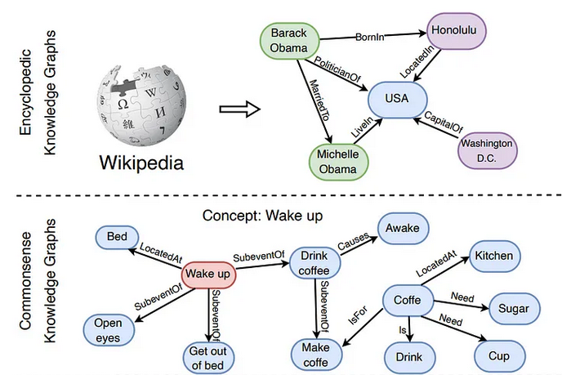
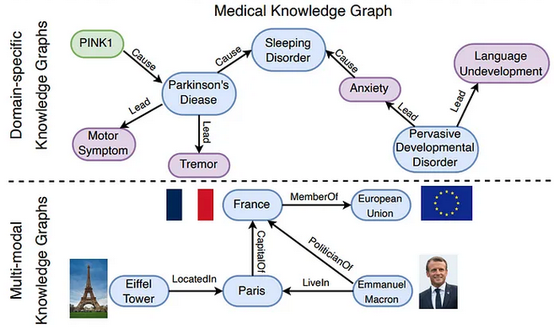
Introduction to NLP

Slide 42
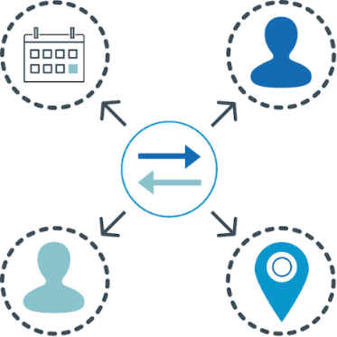
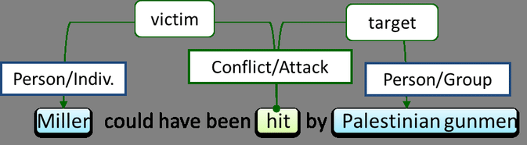



Introduction to NLP
Event Extraction
Temporal Expression Extraction
Event extraction is the task of finding events in which the entities participate.
Temporal expression recognition is a task of finding the start and end of all of the text spans that correspond to such temporal expressions. These temporal expressions can be normalized onto specific calendar dates or times of day to situate events in time.
Temporal Relation Extraction
Temporal Relation Extraction is identifying temporal relations between pairs of events and temporal expressions.
Notes:
Palestinian [.pælə'stɪniən]
Temporal ordering

